Slide 1
“Stress Management For Parents Of Children With Autism”
Dr. Ruwinah Abdul Karim
Clinical Director
Penawar Special Learning Centre

Slide 2



STRESS MANAGEMENT FOR PARENTS OF CHILDREN WITH AUTISM
Dr. Ruwinah Abdul Karim
Clinical Director
Penawar Special Learning Centre (PSLC)

Slide 3
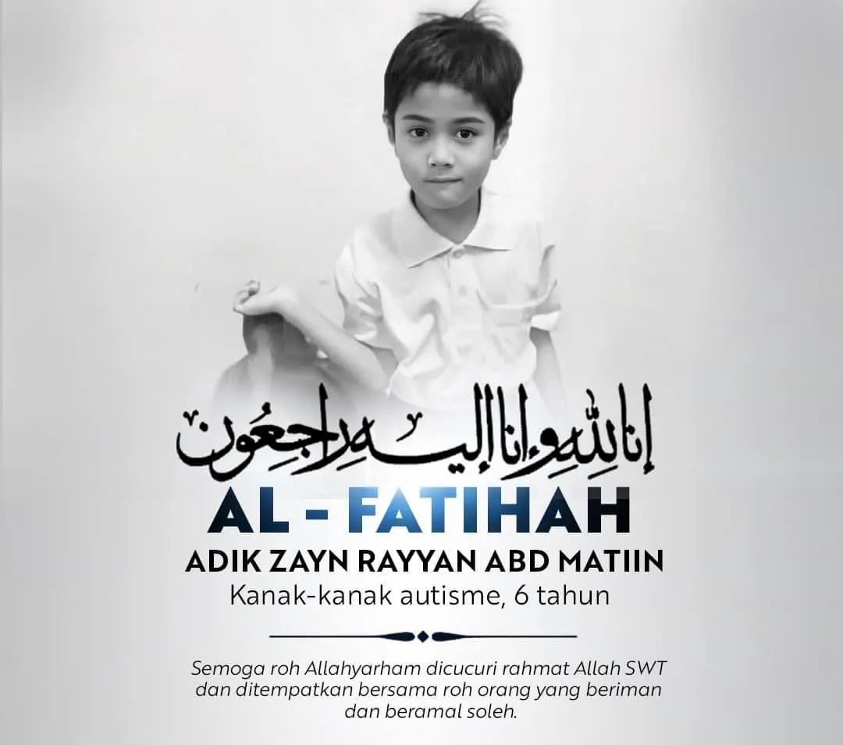

Slide 4
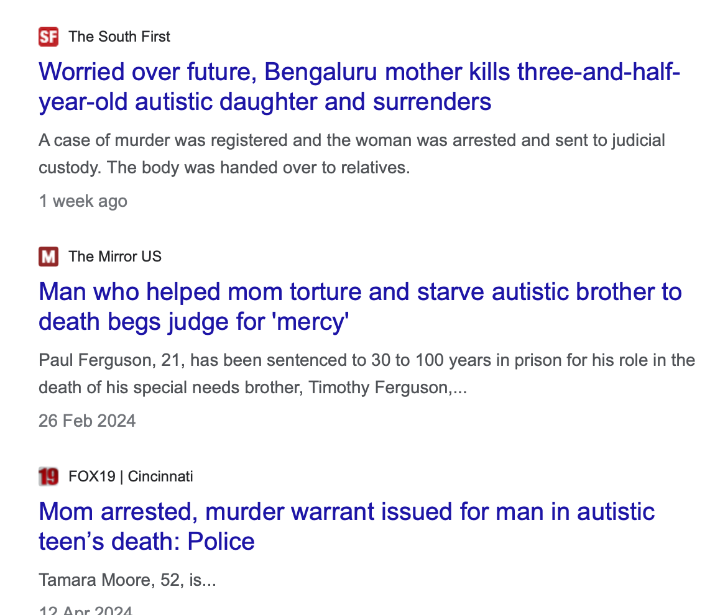
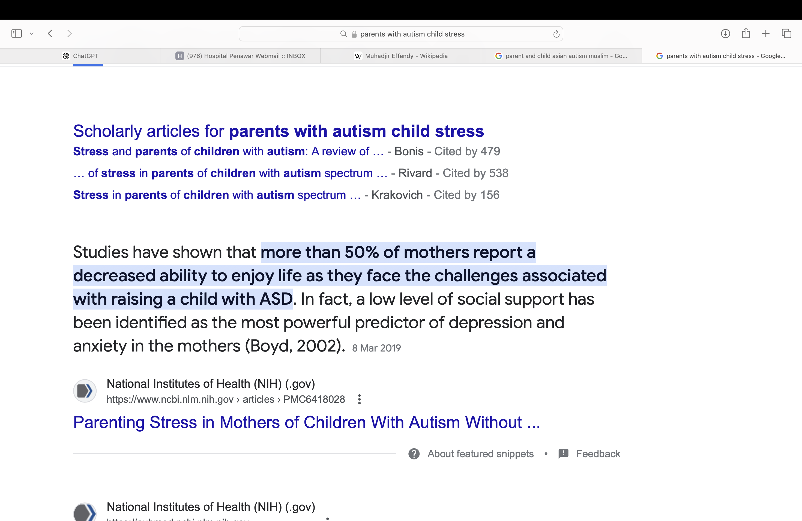
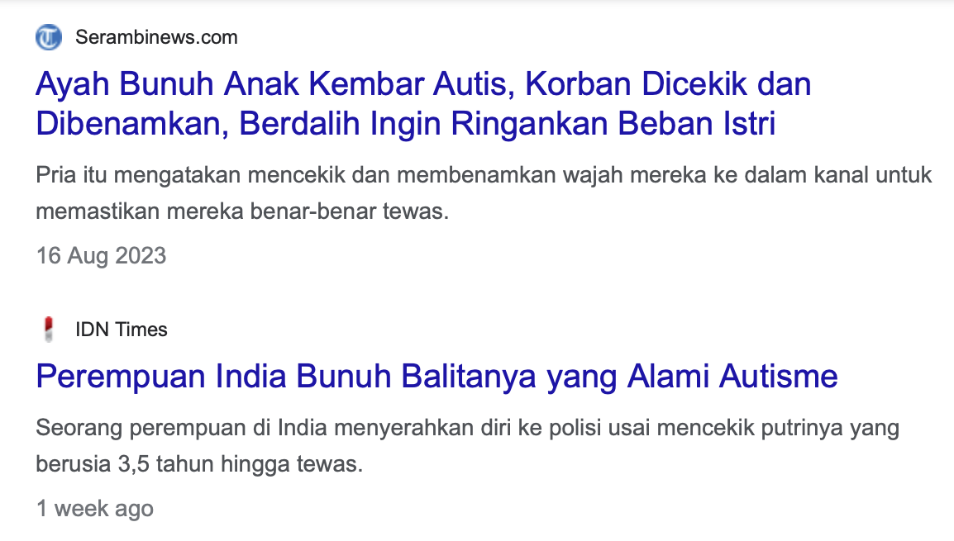
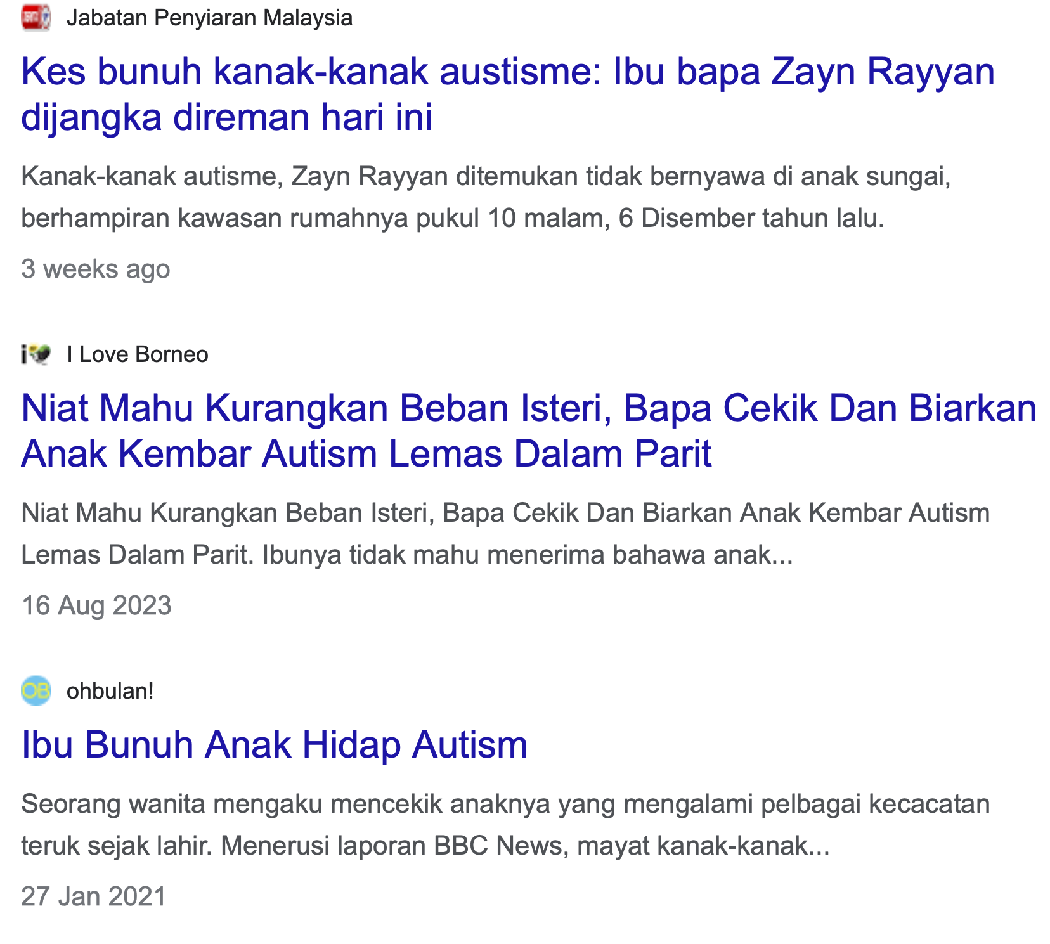

Slide 5
Understanding Autism Spectrum Disorder (ASD)
Understanding that ASD is a spectrum disorder means recognizing that each child may have different strengths and challenges.
01
Learning about the different ways ASD can manifest, such as through social communication challenges or repetitive behaviours.
02
Understanding sensory sensitivities that individuals with ASD might experience, such as sensitivity to sound or touch.
03

Slide 6
Impact of Stress on Parents and Families
Parents experiencing stress due to navigating complex educational or healthcare systems for their child with ASD.
Siblings feeling neglected or overwhelmed due to the demands of caring for a sibling with ASD.

Slide 7
Self-Care Strategies
Parents practicing mindfulness techniques to manage their stress levels.
Engaging in hobbies or activities that provide relaxation and emotional recharge.

Slide 8
Building a Support Network
Joining
Joining local or online support groups for parents of children with ASD.
Connecting
Connecting with other families who have children with similar needs through community events or school programs.

Slide 9
Effective Communication
Using
Using visual aids and structured routines to enhance communication with a child with ASD.
Learning
Learning to use clear and concise language to facilitate understanding.

Slide 10

Managing Time and Responsibilities
Creating schedules and routines that accommodate the needs of the child with ASD and the rest of the family.
Prioritizing tasks and delegating responsibilities among family members.

Slide 11
Identifying Stress Triggers & Coping Mechanisms
Recognizing specific situations or environments that trigger stress for the child with ASD.
Developing strategies like deep breathing exercises or sensory breaks to help manage stress.

Slide 12
Advocacy and Accessing Resources
Advocating for appropriate educational services or therapies for the child with ASD.
Understanding and accessing government programs or nonprofit organizations that provide support and resources.

Slide 13
Promoting Resilience and Positive Parenting
Focusing on strengths and celebrating achievements, no matter how small, to foster resilience in the child with ASD.
Using positive reinforcement and praise to encourage desired behaviors and skills development.
“Resilience, positive parenting, progress, confidence, achievements”

Slide 14

“Autism doesn’t come with a manual. It comes with a parent that never gives up”
Email: ruwinah@hospitalpenawar.com
Syeren: 016-733 1325
Karmina: 019-873 5963

